Slide 1
^{DSI Capstone} ^{11/28 Weekly Update}
Dec 1, 2022

Slide 2
Agenda
1
Project Recap
2
Business Case: Initial Version
3
Business Case: ML Version
4
Next Steps

Slide 3
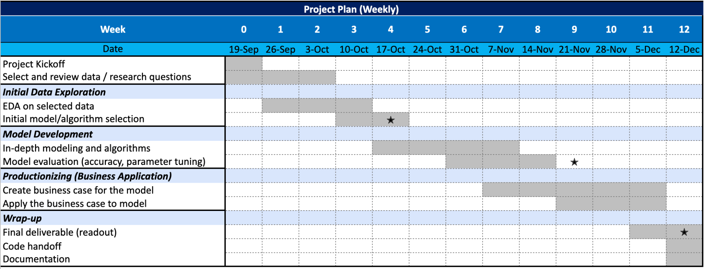
From Last Week: Timeline
1
1st progress report
2nd progress report

Slide 4
Project Recap: defined research question
1
What are the most important factors to consider when choosing EV charging locations in Washington state? Where are potential optimal locations?
A
Why WA
i. WA has comparatively more EV registered and not severely lacking EV stations¹ for us to build models on
ii. WA has enough government-issued data available: https://data.wa.gov/
iii. WA has supporting policies for EVs
EVSE Grants support deployment projects along the state’s highway corridors
EVs and EVSE are eligible for a sales and use tax exemption
Commercial Alternative Fuel Vehicle and Fueling Infrastructure Tax Credit
AFVs are exempt from state emissions control inspections.
Green Public Transit Grant Program provides funding to install EV infrastructure among other green transportation projects

Slide 5
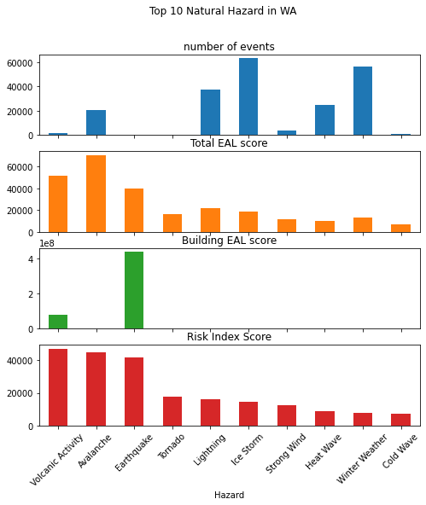
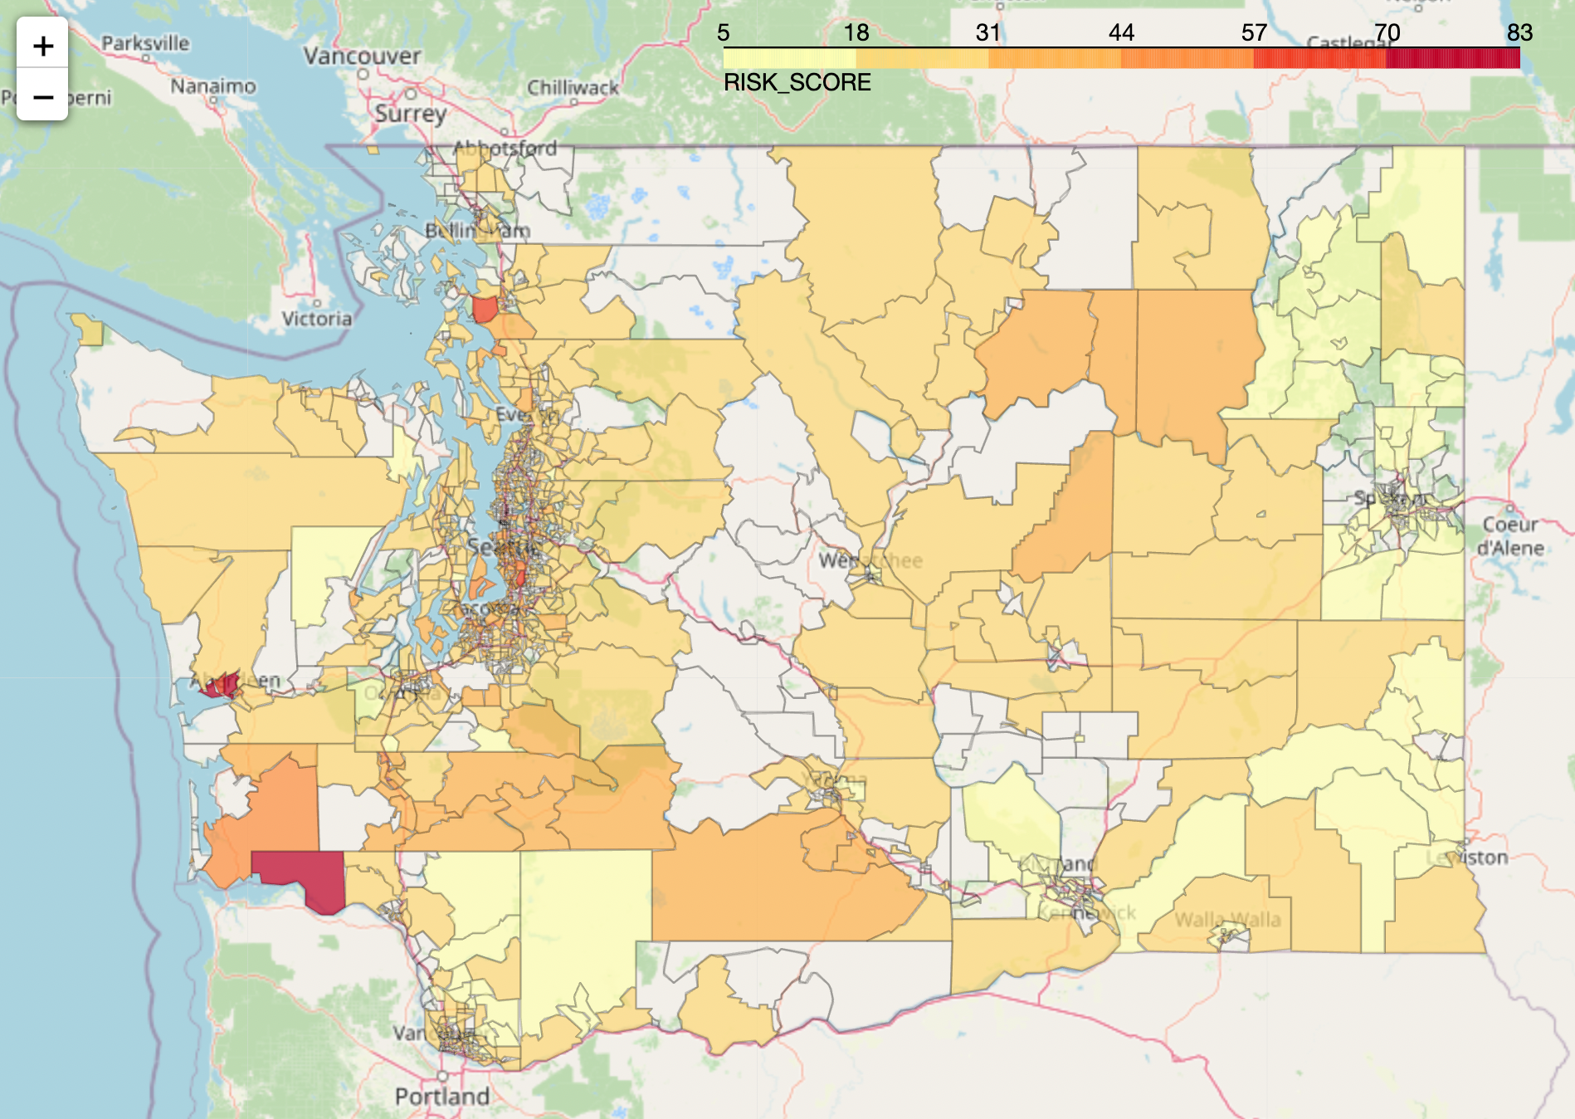
Project Recap: EDA - Natural Risk Index
Expected Annual Loss
Social Vulnerability
1
X
Washington's most common natural disasters include wildfires, floods, severe storms, landslides, earthquakes, tsunamis, droughts, and volcanoes.
Community Resilience
Natural Risk Index highly skewed by population, and property value.
Notes:
Washington's most common natural disasters include wildfires(WFIR), floods(CFLD: Coastal Flooding, RFLD: Riverine Flooding), severe storms(HRCN: Hurricane), landslides(LNDS), earthquakes(ERQK), tsunamis(TSUN), droughts(DRGT), and volcanoes(VLCN). Other less significant disasters include power outages, winter storms(CWAV: Cold Wave, WNTW: winter weather, ISTM: ice storm, HAIL: Hail, AVLN:Avalanche), and tornadoes(TRND). HWAV: Heat Wave
EAL: [Expected Annual Loss](https://hazards.fema.gov/nri/expected-annual-loss)
Expected Annual Loss (EAL) represents the average economic loss in dollars resulting from natural hazards each year. It is calculated for each hazard type and quantifies loss for relevant consequence types: buildings, people, and agriculture.
SOVI: [Social Vulnerability](https://hazards.fema.gov/nri/social-vulnerability) (Min-max normalized)
Social vulnerability is the susceptibility of social groups to the adverse impacts of natural hazards, including disproportionate death, injury, loss, or disruption of livelihood.
RESL: [Community Resilience](https://hazards.fema.gov/nri/community-resilience)
Community resilience is the ability of a community to prepare for anticipated natural hazards, adapt to changing conditions, and withstand and recover rapidly from disruptions.

Slide 6
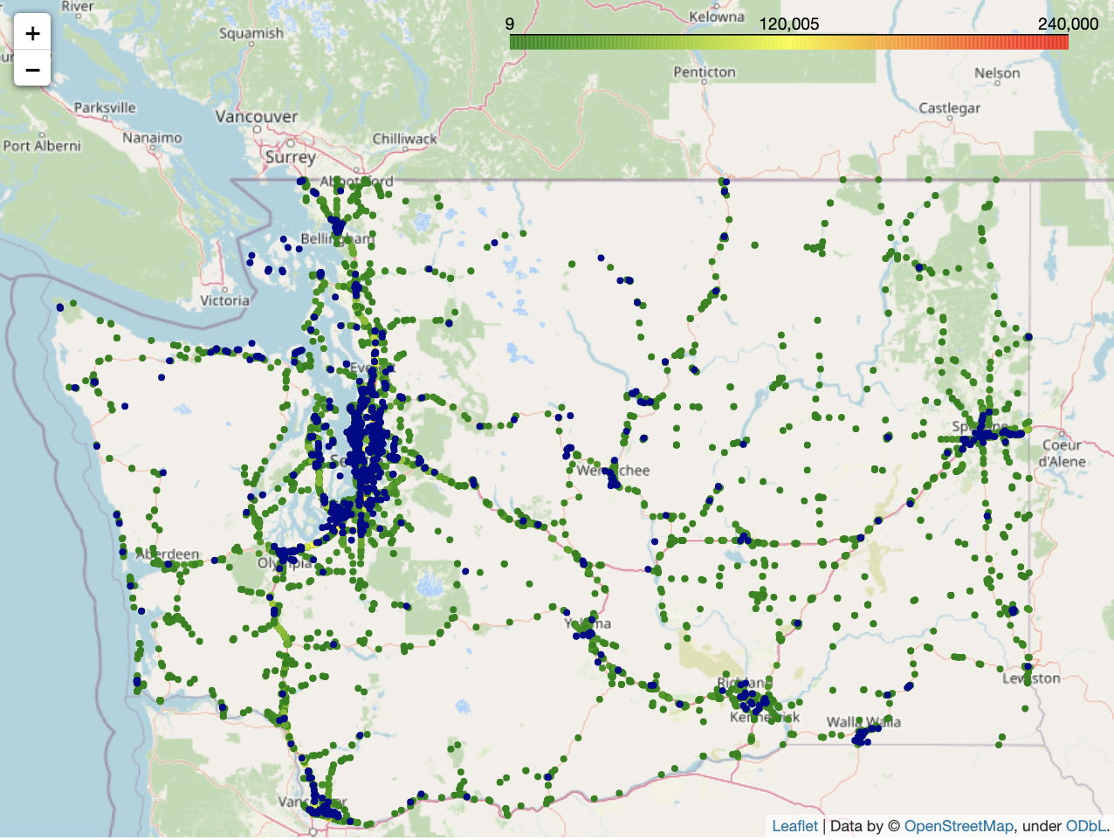
Project Recap: EDA - Annual Average Daily Traffic
1
: EV charging stations
Some areas accessible from Annual Average Daily Traffic are without enough EV stations
: annual average daily traffic
~1% of total annual average daily traffic (AADT)
Approximate total AADT in circled area: 1,716,549
~3% of total annual average daily traffic (AADT)
Approximate total AADT in circled area: 5,069,390
~4% of total annual average daily traffic
Approximate total AADT in circled area: 6,243,820
Notes:
plot ev stations along with traffic data, identified 3 areas with traffic but lacking EV chargers

Slide 7
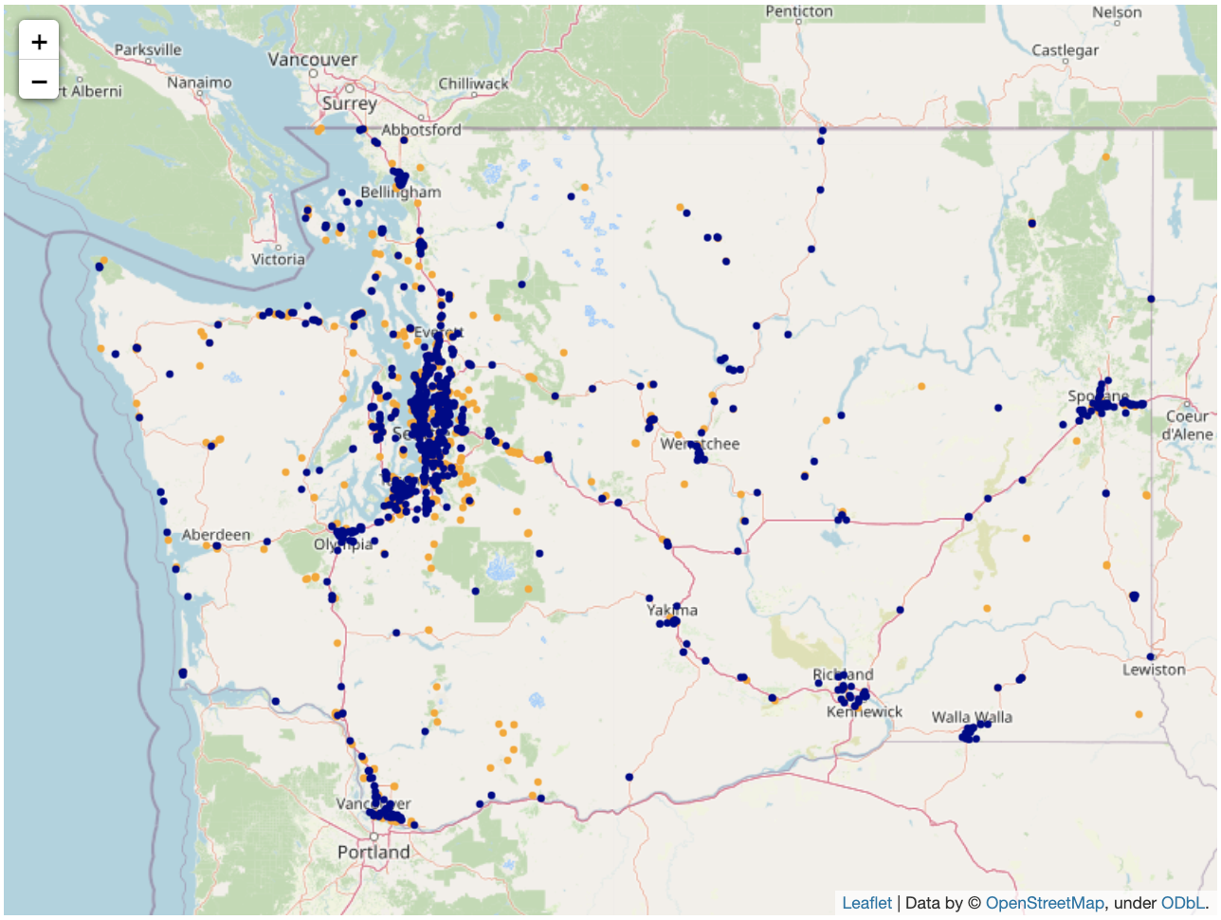
Project Recap: EDA - tourism locations
1
: EV charging stations
: Tourism locations
Tourism locations¹ are potential locations for EV charging stations because it…
shows where people may be willing to spend their time for several hours
is reachable from electricity
may be located in rural area between two cities
opportunities exist to build EV chargers around tourism locations
1. Tourism locations include tourist attractions, artworks and entertainments (e.g. theaters, casino, community center, etc.)

Slide 8
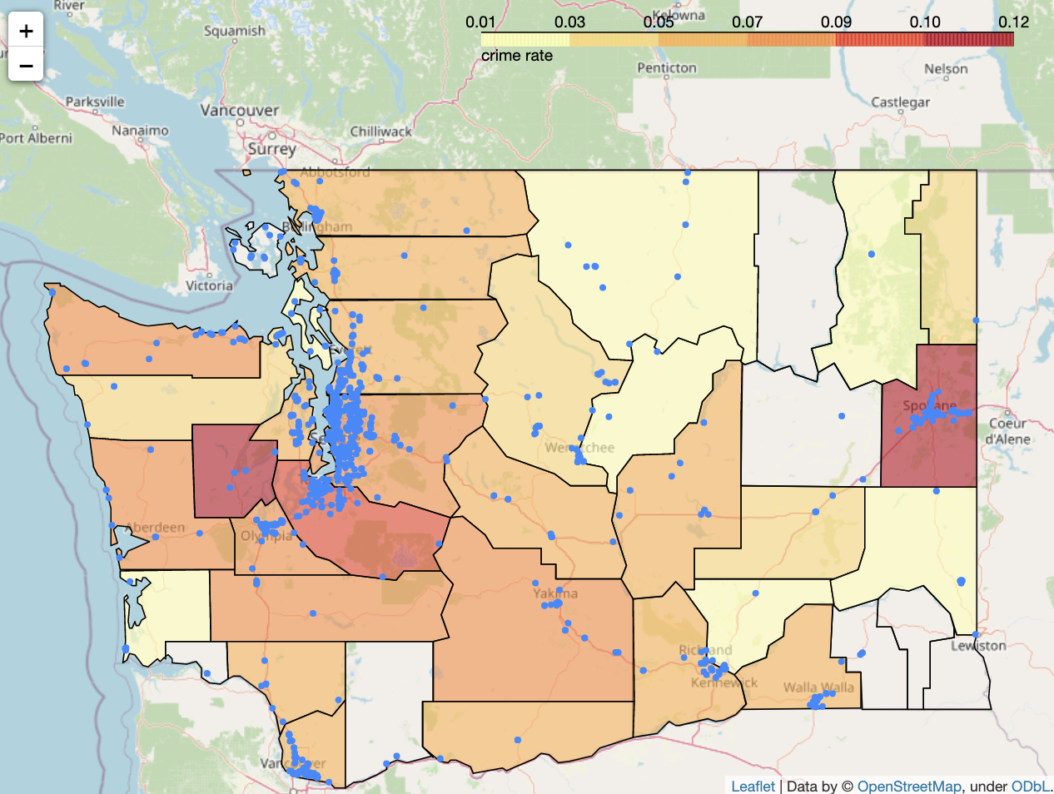
Project Recap: EDA - crime rate
1
Crime rate (total crimes¹ / population) indicates the dangerousness of the neighborhood in specific counties², which may affect the willingness of the traveller to leave their EVs in some areas
: EV charging stations
Rural areas has comparably lower crime rate
Most of current EV charging stations are not located in high crime rate areas, except some crowded charging stations in Spokane
Assumed ideal places for EV chargers discussed in previous slides are mostly located in low crime areas
1. Crime counts includes violent, murder, repel, robbery, assult, property crime, bulglary, larceny theft, motor theft and arson.
2. Note that original data is in city-level, here we generalized it to counties so there may be biases when seeing a whole county as “high crime rate”

Slide 9
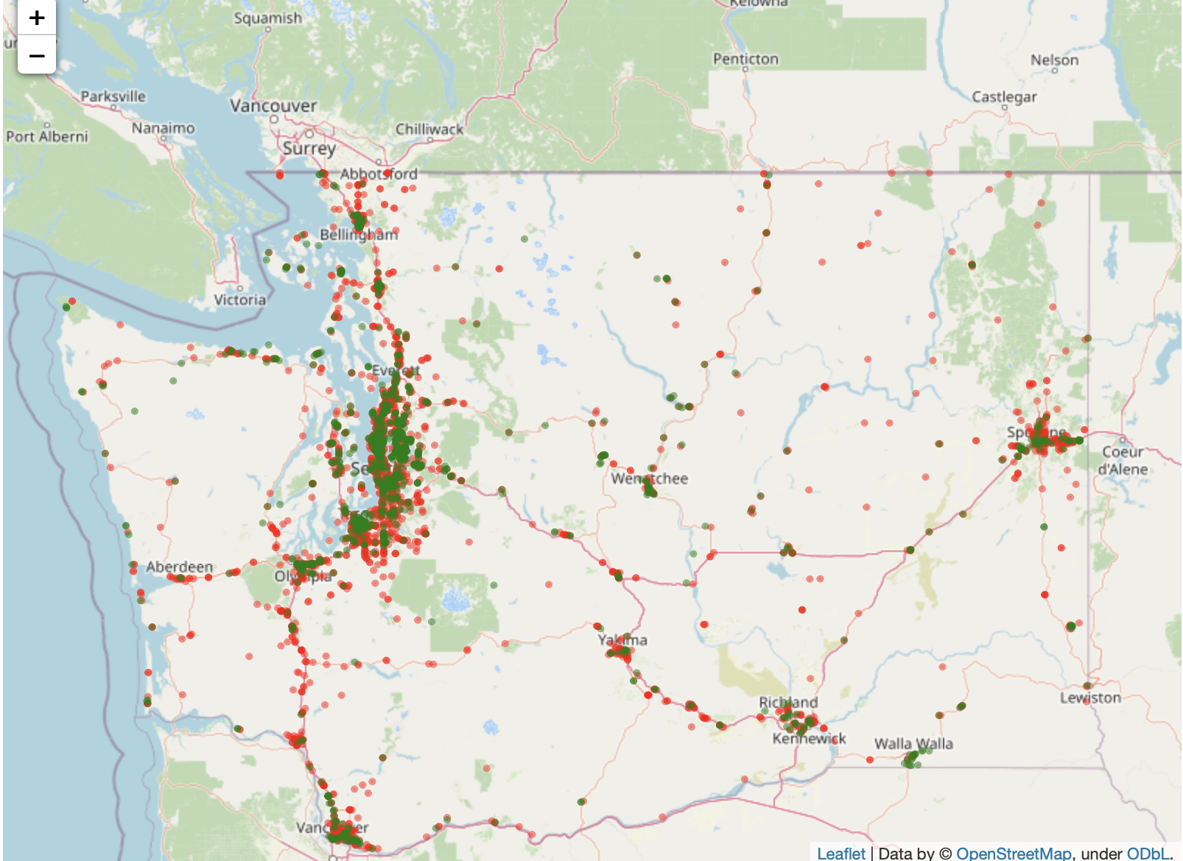
Project Recap: EDA - gas station locations
1
Gas chargers and convenience stores in gas stations need to be powered by electricities, so the location of gas stations tells the electricity accessibility
: EV charging stations
: Current gas stations
Most current EV Charging Stations overlap with gas stations in city areas but not along rural routes
Our proposed EV charging station areas shows gas station presence, which indicates that e-grid can reach those areas

Slide 10
Project Recap: data combination for modeling
1
Data entry:
gas stations
name
latitude
longitude
1. Traffic
2. Highway exits
Average traffic counts within 5 miles / 10 miles of driving distance
Max traffic counts within 5 miles / 10 miles of driving distance
Route distance to closest highway exit (only available for locations within 5-mile width of highway corridor)
3. EV chargers
4. Attractions
1 data file
Distance to closest EV station
# of EV stations within 2 miles, 5 miles, 10 miles, 20 miles, 50 miles of driving distance
Attraction counts within 1 mile / 5 miles of driving distance
Closest attraction to each gas station and its distance
5. Crime
6. Natural risk index
Total crime count in the county where the gas station is located
Risk index in the county where the gas station is located

Slide 11
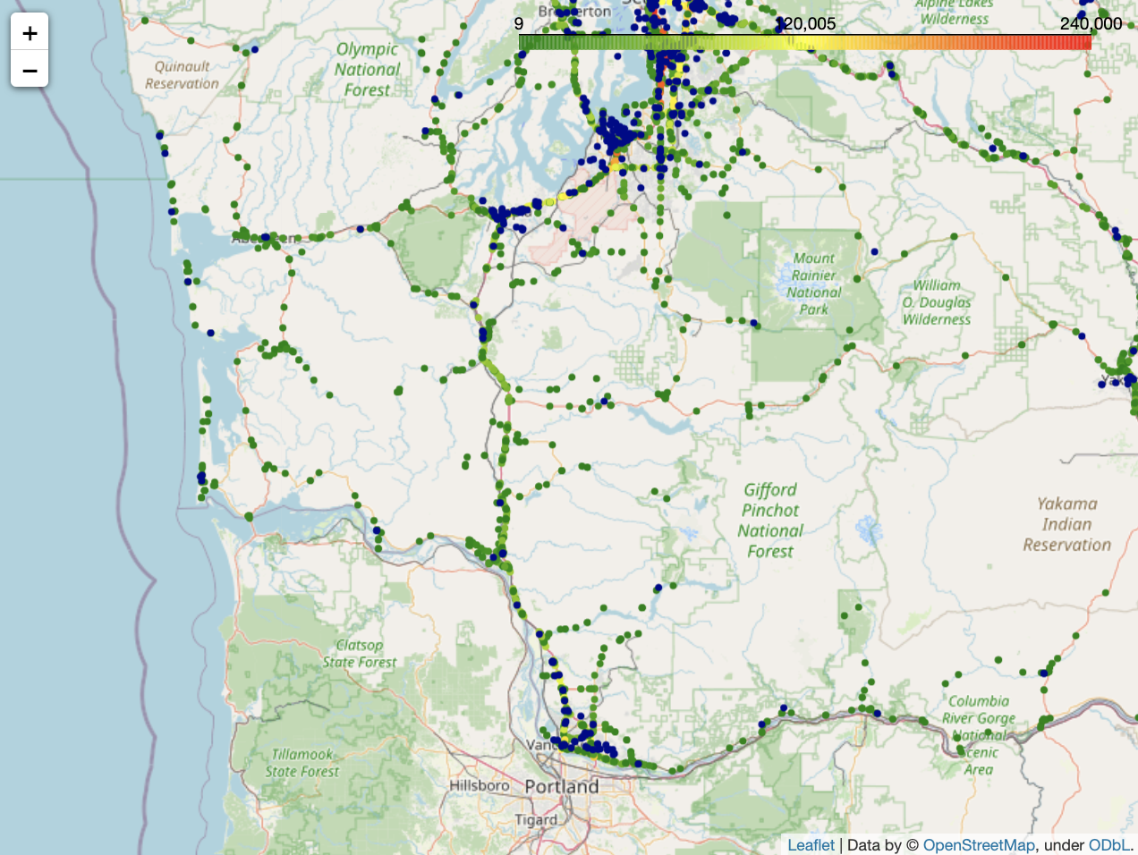
Project Recap: initial modeling focuses on I-5 south area
Initial Modeling area focuses on I-5 Route (Olympia - Vancouver), then expand to other highways
1
: EV charging stations
: annual average daily traffic
I-5

Slide 12
Project Recap: classification model
1
Idea: use a supervised ML model to give a rough baseline EV charging station locations using gas station location
Based on our current gas station and EV station data, in our selected area (I-5 south), which gas stations can be chosen as locations to place EV chargers
Target
Within 20m precision, whether there is a EV station for each gas station location (whether the location is possible to place EV station)
1 - there exists a matched EV station
0 - there isn’t a matched EV station
Data Preprocessing
Missing data in risk index & crime rate due to lack of records
risk index: fill with average
crime rate: fill with minimum
Remove highly correlated and unuseful features (including id, name, lat/long, etc).
Drop if correlation > 0.8
17 features remaining
Used SMOTE to balance target
Data
Training & validation: all gas stations except ones near I-5 south
Testing/deployment: gas stations near I-5 south
Features
2711 gas stations with 57 features
Imbalanced target
63% unmatched gas stations (0)
37% matched gas stations (1)
Evaluation Metrics
Recall: % of predicted matched among all real matched
Average Precision: averaged accuracy on 1s and 0s
AUROC: provides an aggregate measure of model performance
Notes:
Idea: make good use of the distribution of current gas stations and EV stations
Use a ML model to give a baseline idea: based on our current locations, in our selected area (I-5 south), which gas station can be a location to place EV chargers
Target - use geohash with precision = 8 (20m error on axis) to categorize each gas station and EV station together, match them with geohash encoding
Data - gas stations near i-5 south don’t have target
Feartues
SMOTE: adds synthetic interpolated samples to minority class -> same # of 0 & 1s
our dataset is not too large so creating more data works fine
Evaluation Metric
Recall: our cost of false negative (predict actual matched location as unmatched) is high

Slide 13
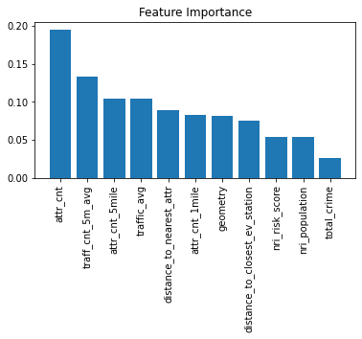
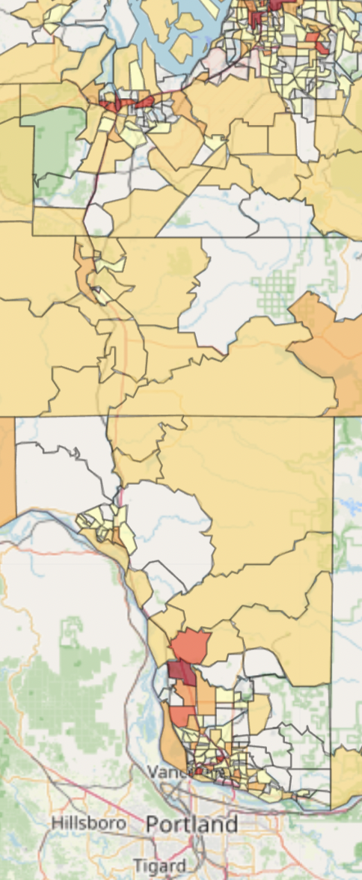
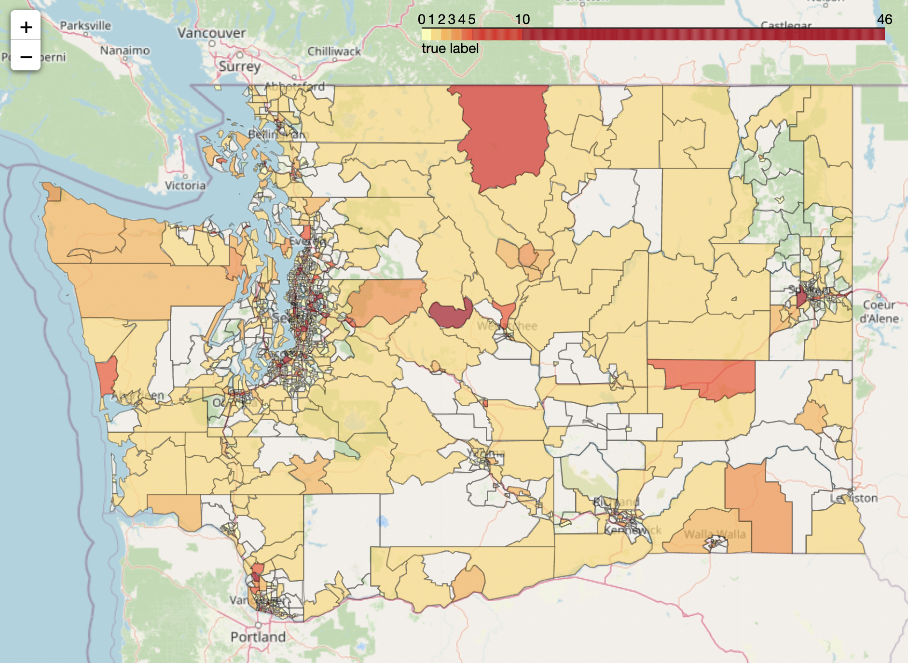
Project Recap: generalization
1
The model is trained and validate on census tracts with existed EV stations or labeled as ‘urban’. Best model results after randomized search with cross validation:
training MSE: 1.151, validate MSE: 0.941
training r-squared: 0.886, validate r-squared: 0.885
11 out of 35 features were selected. Highly correlated and unuseful features are removed.
The number of attractions is the most important feature, followed by average daily traffic in the area.
Notes:
Last week, we assumed that the number of EV stations in urban area is optimal. However, the model predicted mostly zeros. Hence this week, we also include rural census tracts with existed EV stations. The model is now trained and validated on census tracts with existed EV stations or labeled as ‘urban’. Best model results after randomized search with cross validation is shown here. We selected 11 features out of 35, and number of attractions is still the most important feature.
There are some empty areas in the graph. These are the census tracts lacking gas stations. Since our data points are generated by each gas station, the model are not able to make predictions in those area.

Slide 14
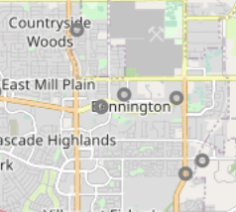
Project Recap: optimization model explanation ¹
1
Variable
Each gas station location
(output will be charger numbers in each location)
Average EV traffic coverage per charger within 1 miles based on current state (ratio²):
168
Objective function
Version 1 - Minimize proposed EV charger cnt in all stations
Version 2 - Minimize total distance to nearest exists from all stations
Constraints
Fixed constraints:
Driving distance to highway exit < 10 miles
Constraints varied by variables:
All traffic demand satisfied:
(Proposed EV charger cnt at this location + existing EV charger cnt within 5 miles + proposed EV charger cnt within 5 miles) * ratio² >= EV traffic cnt
Proposed EV charger cnt at this location < 10 ³
1.
2. total traffic ratio = traffic count within 1 miles / # of EV stations within 1 miles for each Seattle (busy) area I-5 exits
take the average of each ratio on exits and come to the final ratio
To approximate the EV traffic, we multiply the total traffic by 1.6%
3. We can only apply this constraint to small models due to Gurobi License limitation
✕
2.5 miles
5 miles
✕
✕
10
10
10
10+10 = 20
Old model
New model

Slide 15
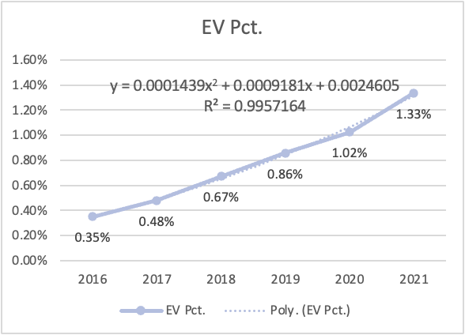
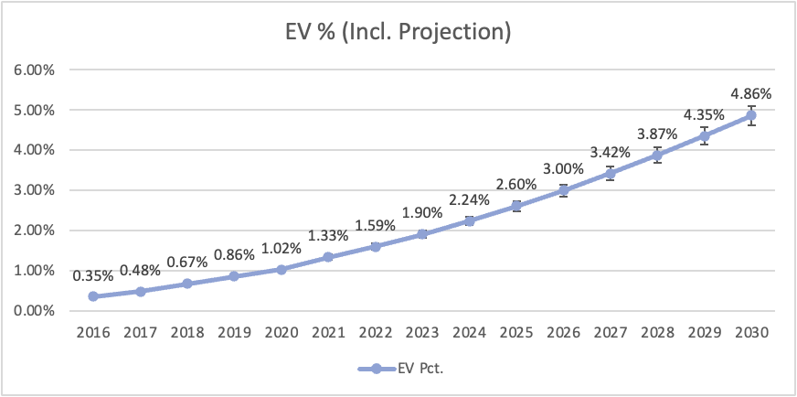
Project Recap: future EV% projection
1
Year | EV Pct.
2016 | 0.35%
2017 | 0.48%
2018 | 0.67%
2019 | 0.86%
2020 | 1.02%
2021 | 1.33%
2022 | 1.59%
2023 | 1.90%
2024 | 2.24%
2025 | 2.60%
2026 | 3.00%
2027 | 3.42%
2028 | 3.87%
2029 | 4.35%
2030 | 4.86%
The projected percentage of EVs, from 2022 to 2030, is quadratic-interpolated from registered vehicles in WA state, from 2016 to 2021.
Includes EV and plug-in hybrid vehicles
5% Error bars are added
Data Source: (Alternative Fuels Data Center) https://afdc.energy.gov/transatlas/#/?state=WA&view=vehicle_count&fuel=ELEC

Slide 16
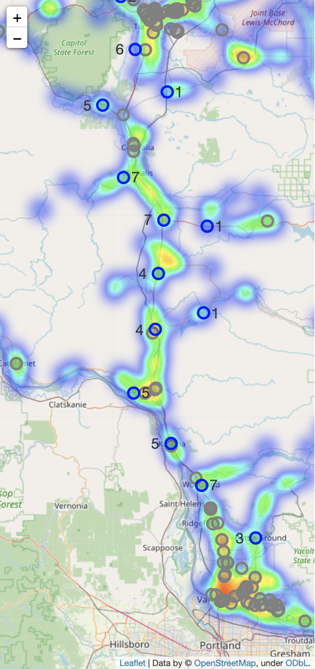
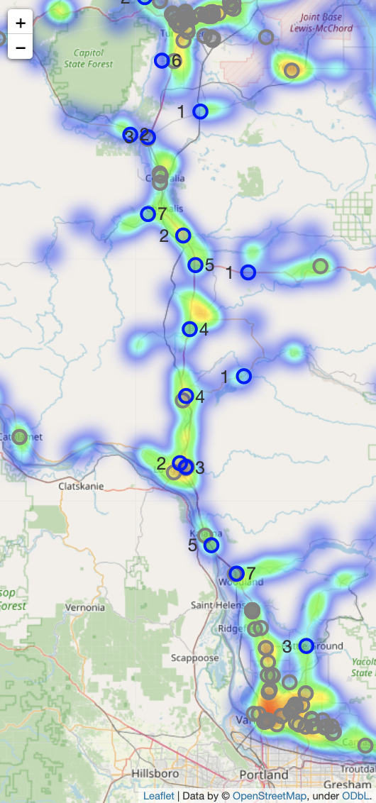
Project Recap - current demand scenario (2022)
1
: Existing EV charging location
: Suggested new EV charging location
Version 1:
Minimize proposed EV charger cnt
EV% = 1.6%
Suggested 13 locations
Est. cost: ~$785,000
Version 2:
Minimize total distance to nearest exists
EV% = 1.6%
Suggested 16 locations
Est. cost: ~$874,000
Evaluation metric - cost:
cost building stations + cost adding chargers + cost driving from exits to each station
$30,000 - cost per station
$8,000 - cost per charger
$0.15 - cost driving per mile per EV car
The only difference between the two models is that, in some area, one station is divided up into two or more stations closer to exits
Version 1 saves ~$90,000
Model version: pandas: 1.3.5, gurobipy: 9.5.2 (detail see appendix)

Slide 17
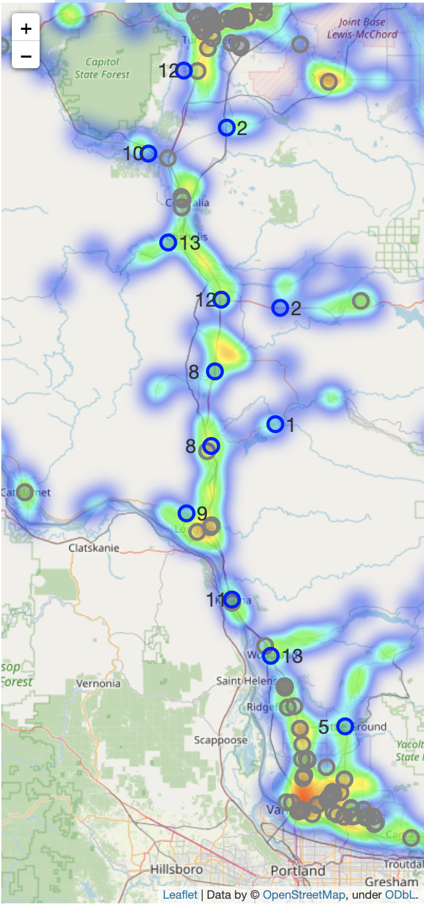
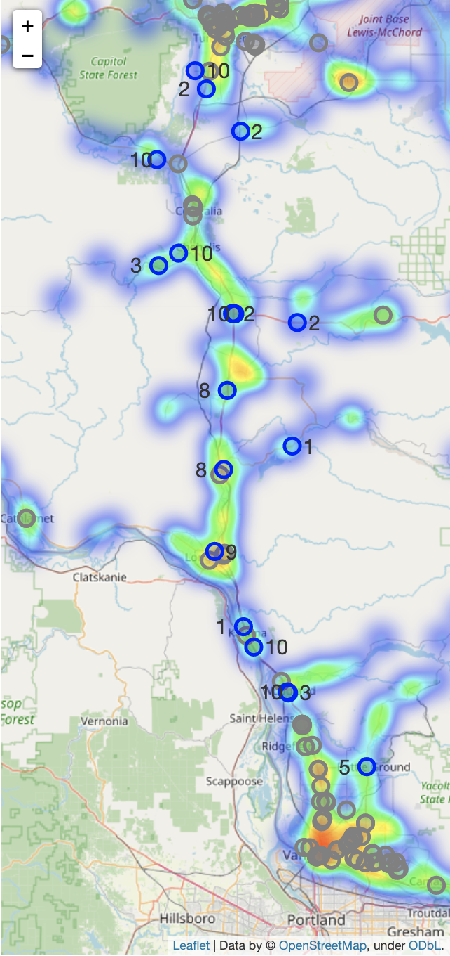

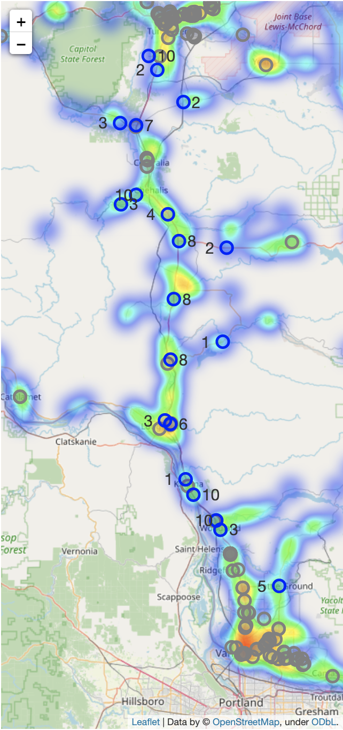
Project Recap - future demand scenario (2026)
1
: Existing EV charging location
: Suggested new EV charging location
Version 1:
Minimize proposed EV charger cnt
EV% = 3.0%
Version 2:
Minimize total distance to nearest exists
EV% = 3.0%
Version 1 saves ~$60,000
The cost difference between two versions is largely affected by the cost for building additional stations when demand is comparatively small
:
Apply “proposed EV charger cnt per location < 10” costraint
Suggested 13 locations
Est. cost: $1,289,000
Suggested 16 locations
Est. cost: $1,349,000
Model version: pandas: 1.3.5, gurobipy: 9.5.2 (detail see appendix)

Slide 18

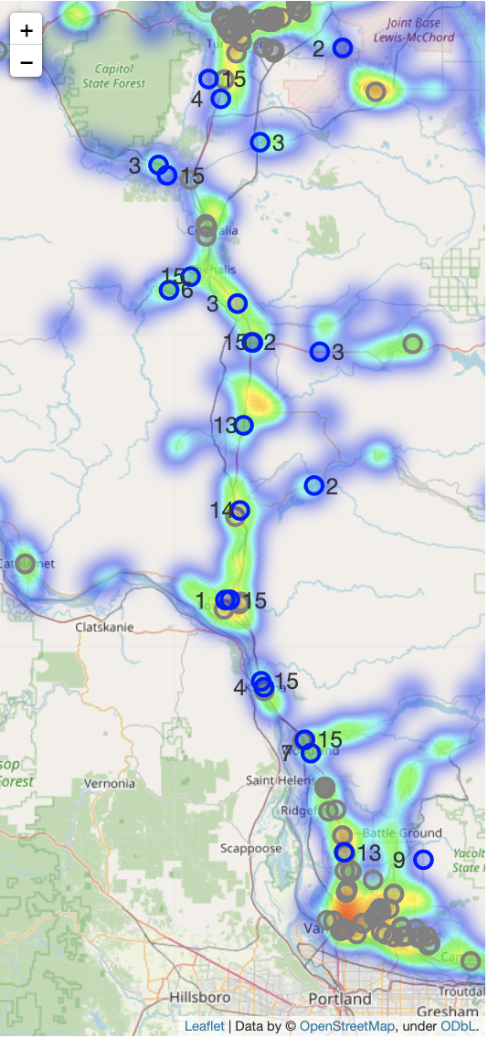
Project Recap - future demand scenario (2030)
1
: Existing EV charging location
: Suggested new EV charging location
Version 1:
Minimize proposed EV charger cnt
EV% = 5.0%
Suggested 23 locations
Est. cost: $2,064,000
Version 2:
Minimize total distance to nearest exists
EV% = 5.0%
Suggested 24 locations
Est. cost: $2,092,000
Version 1 saves ~ $29,000
As EV traffic percentage increases, the cost difference between two versions is getting smaller if we restrict # of chargers per station, meaning version 2 works better than version 1 when EV gets more dominant in market.
Model version: pandas: 1.3.5, gurobipy: 9.5.2 (detail see appendix)

Slide 19
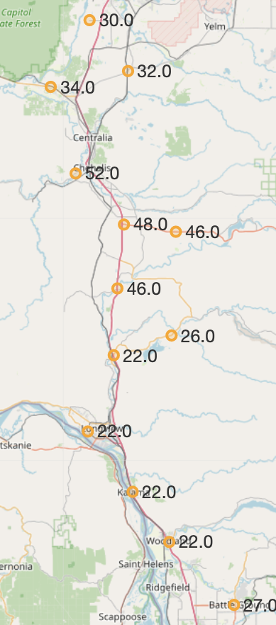
Project Recap: naive score on optimized locations
1
Idea
Create a linear combination on selected features
Features
# of attraction/entertainments within 1 mile driving distance
Crime rate (includes violent crime, murder, rape, robbery, assault, property crime, burglary, larceny theft, motor vehicle theft, arson)
Take total and calculate rate based on population
Natural risk score
Weights
All same (1) on three features
Process
Use min-max scaler on each three features to make the number from 0 to 1 on all data
Add each features together:
1*# of attractions in 1 miles - 1*total crime rate + 1*natural risk score
Use min-max scaler on the score to make them from 0 to 1
Query the score on optimized locations
Improvement
Total crime -> different weights on different types of crime
e.g, put more weight on motor vehicle theft comparing to arson
All same weight for three features -> different weights on three features
Add machine learning methods for comparison: based on current established patterns, what will be the score for each location
Notes:
Mutually exclusive here: no consideration for distance from exists and traffic since used them in optimization

Slide 20
Project Recap: From Last Week
1
Action items:
Finish 2nd report (required by Columbia DSI Capstone project course) and poster
Improve evaluation metric on models
Gather more data on unit cost on station/charger/driving per mile
Modify business case: adjust weights and try other models

Slide 21
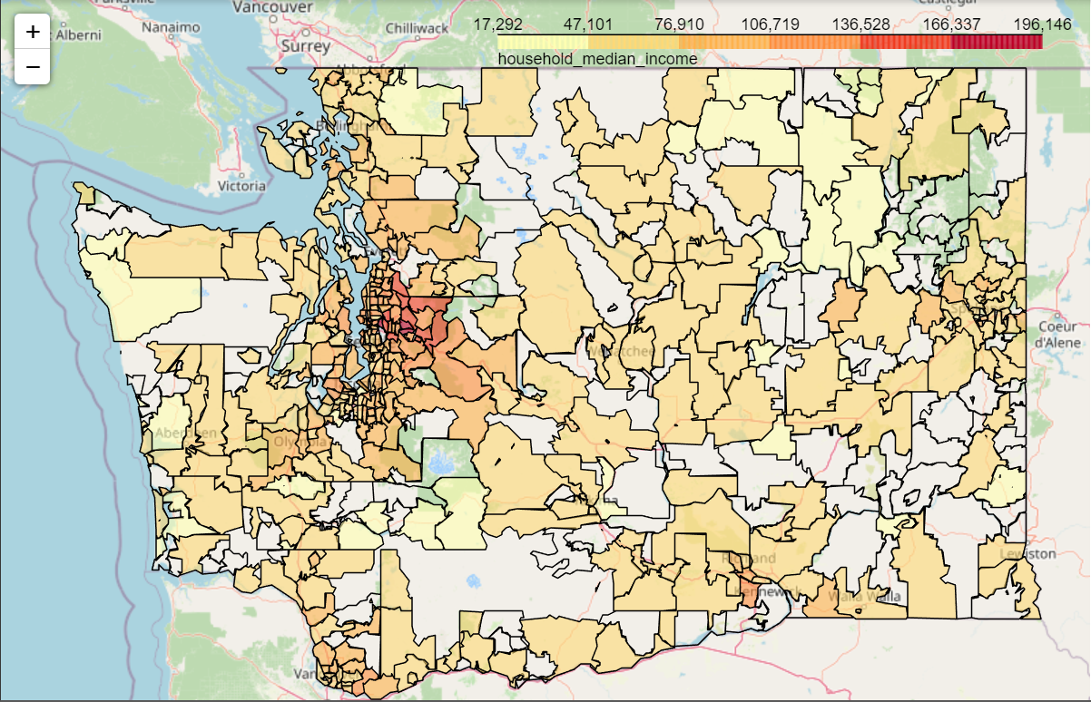
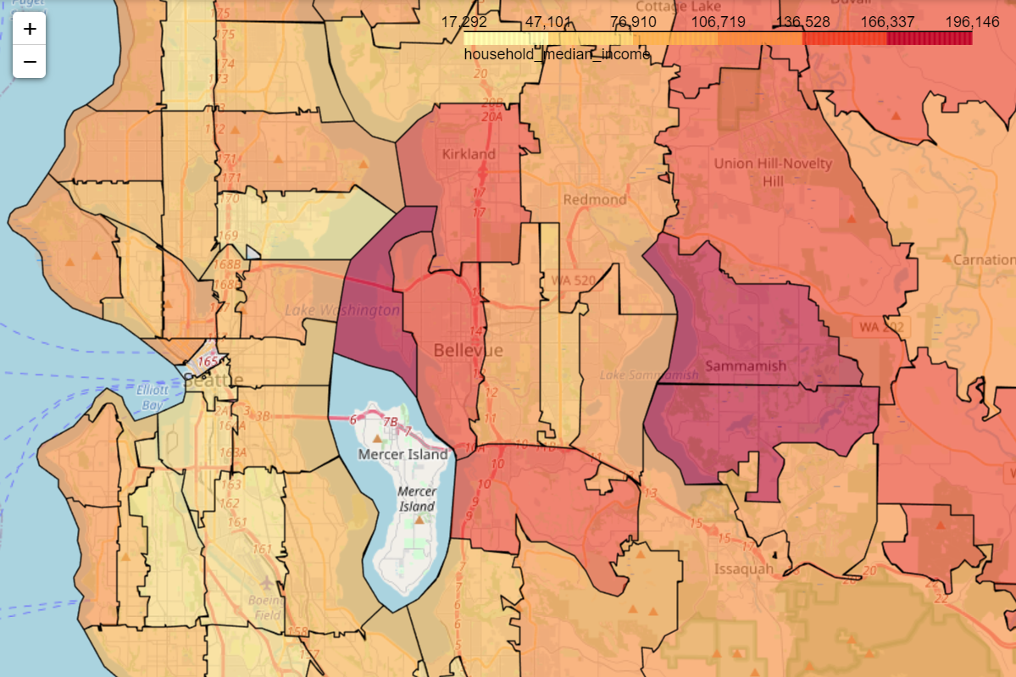
Business Case: EDA - median household income by zip code
2
The distribution is as expected
Transparent areas are locations without income record
Most transparent areas are national forest areas
Higher median household income area around Seattle city area

Slide 22
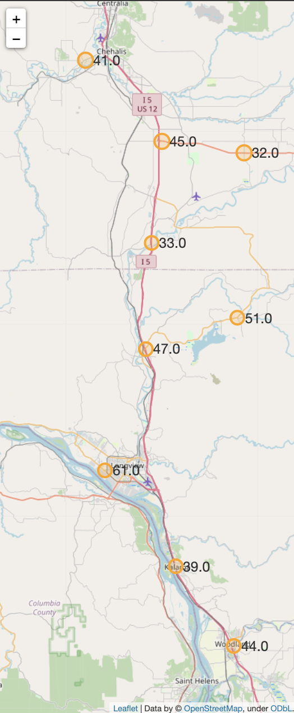
Business Case: improved baseline score on optimized locations
2
Considering that we are planning to place more EV chargers in communities that include rural, disadvantaged, and hard-to-reach areas, we include median household income as a feature to penalize score for developed areas
Idea
Create a linear combination on selected features
Features
# of attraction/entertainments within 1 mile driving distance
Crime rate (includes violent crime, murder, rape, robbery, assault, property crime, burglary, larceny theft, motor vehicle theft, arson)
Take total and calculate rate based on population
Natural risk score
Median household income
Weights
All same (1) on all 4 features
Process
Use min-max scaler on each three features to make the number from 0 to 1 on all features
Add each features together based on whether larger number means worser:
1*# of attractions in 1 miles - 1*total crime rate - 1*natural risk score - 1*median household income
Use min-max scaler on the score to make them from 0 to 1
Query the score on optimized locations
Notes:
Mutually exclusive here: no consideration for distance from exists and traffic since used them in optimization

Slide 23
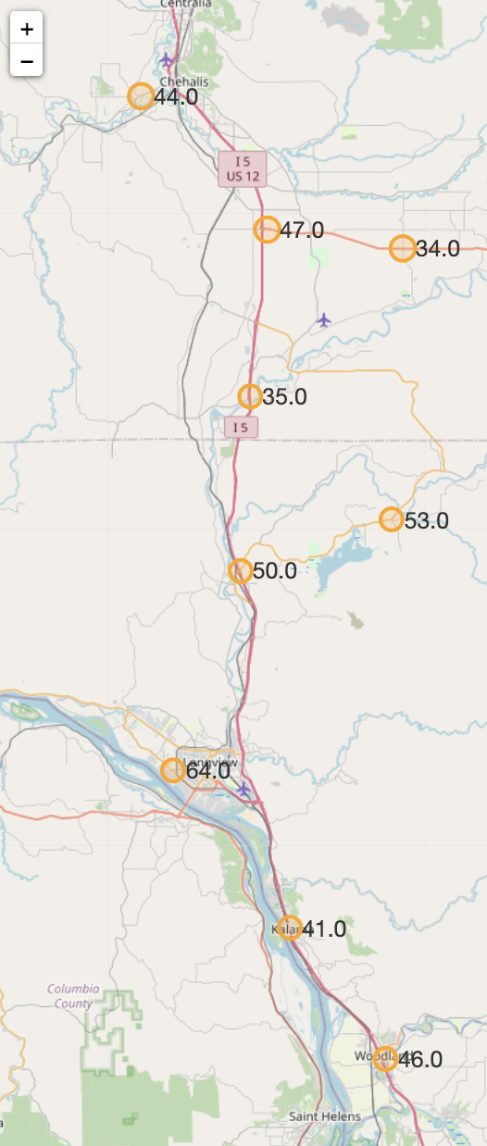
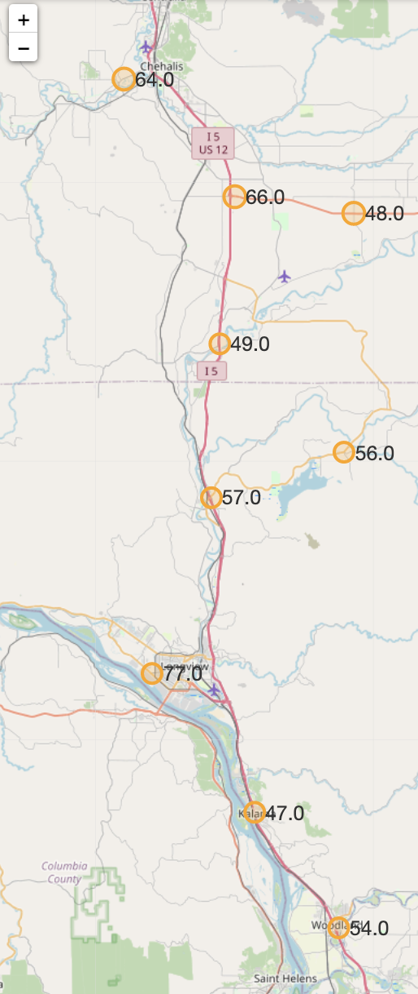
Business Case: baseline score with different weights (manually)
2
Score formula: a*# of attractions in 1 miles - b*total crime rate - c*natural risk score - d*median household income
Equal weight
Decrease weight on attraction
Increase weight on median household income
Even the actual scores increased, the relative importance of these stations among all others stays the same
the relative importance of these two stations flipped as we increase the weight on median household income
Weights:
a: 1
b: 1
c: 1
d: 1
Weights:
a: 0.5
b: 1
c: 1
d: 1
Weights:
a: 0.5
b: 1
c: 1
d: 2
: Model suggested EV charging location
# : predicted score
: Highest score location

Slide 24
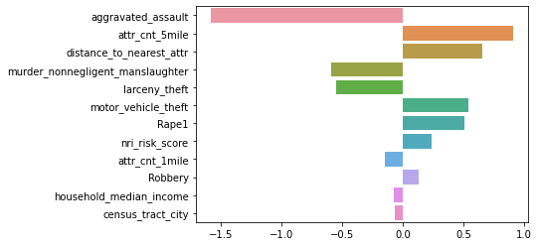
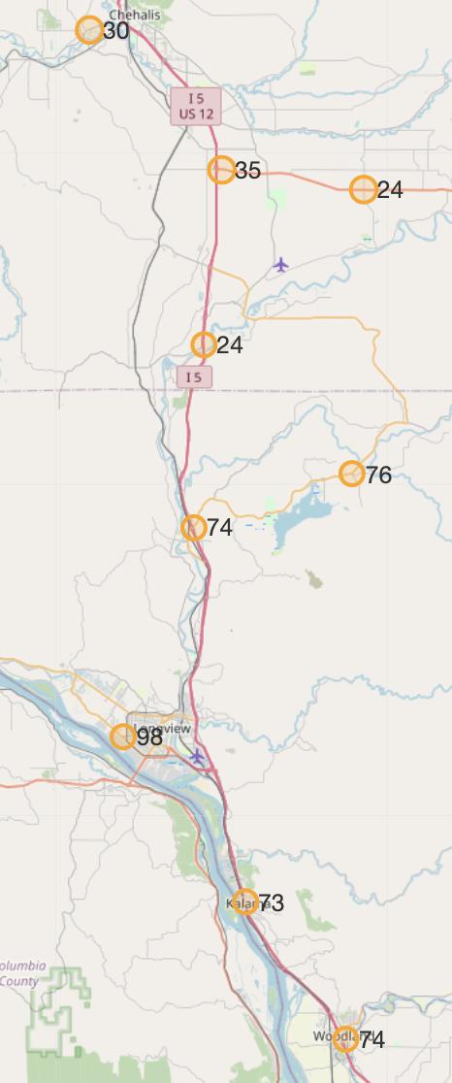
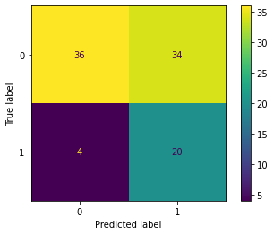
Business Case: logistic regression achieved ~83% recall
3
Comparatively small dataset
: Modeled EV charging location
# : predicted score
: Highest score location
Binary target
Feature Importance
Easy to interpret
Scores here are relatively much lower than expected in baseline model
Logistic Regression
Model Deployment
The general score pattern is similar to the unweighted baseline score
Recall: ~83%
Average Precision: ~40%
Accuracy: ~60%
Similar model performance compared to tree-based models
Model Performance
We don’t care whether the model predicted unmatched gas stations as EV because our goal is to have more EV stations
Scores here are relatively higher than expected in baseline model
Notes:
Feature importance result corresponds to our expectation - crime rate, natural risk index and traffic

Slide 25
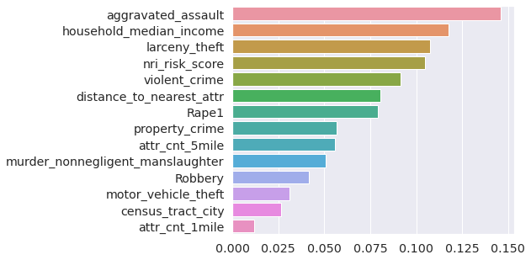
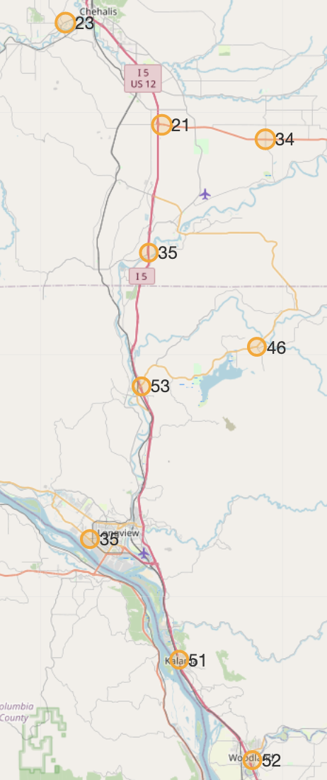
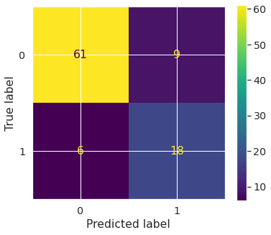
Business Case: random forest regression achieved ~75% recall
3
Compatible with all types of data
: Model suggested EV charging location
# : predicted score
: Highest score location
Feature Importance
Avoid Overfitting
Random Forest
Model Deployment
Scores here are relatively much lower than in logistic regression, especially the top location which showed near 100 in logistic model
Recall: ~75%
Average Precision: ~67%
Accuracy: ~84%
Better performance compared to boosting (xgboost)
Model Performance
The model performance is comparatively good
Notes:
Feature importance result corresponds to our expectation - crime rate, natural risk index and traffic

Slide 26
Next Steps
4
Action items:
Create final readout for the whole project
Improve business case
Adjust weights on baseline model
Improve ML model

Slide 27
Appendix

Slide 28
Python Libraries Used
pandas: 1.3.5
numpy: 1.21.6
gurobipy: 9.5.2
geopy: 1.17.0
folium: 0.12.1.post1
requests: 2.23.0
json: 2.0.9

